Slide 1
Mu Sigma’s Competencies in Working with OSD
RFP Response – Global Insights & Analytics Team
July 5, 2011

Slide 2
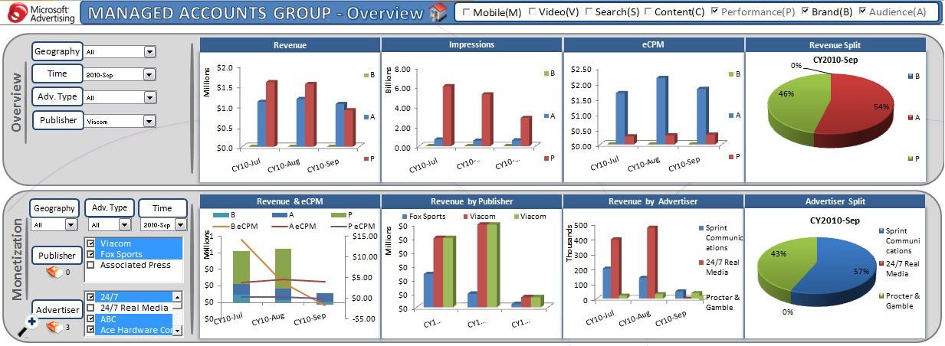
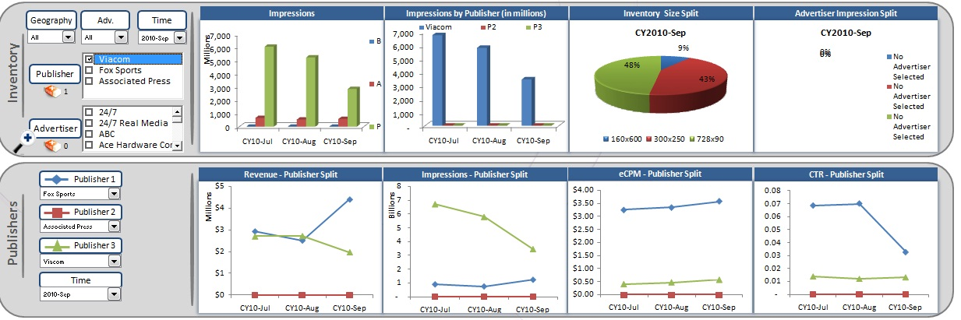
Managed Accounts (MAPP)– Dashboard provided the Publisher BG with a 360 degree perspective of online advertising performance
Case Study – MAPP Dashboard
Business Case
Impact
Ever fluctuating online advertising market needs a close and accurate monitoring of key metrics
Visibility and accuracy of numbers are key requirements from client to take right decision at right time
Multiple data sources makes visibility of numbers very difficult at the same time as too many sources also proved to be reason for inaccurate numbers
Provides an unified view of 3PL publishers by reporting KPIs across Display, Search, Content & Video Business
Provides both Demand(Advertisers) and Supply(Publishers) perspective
Identify major revenue contributors and study trend/relative performance across various KPIs
More granular level reporting on Display, search & Content Business along with identifying the advertisers at risk
Approach
The Dashboard covers Display, Search, Content & Video ad offering, hence there are multiple data sources . The access to all data sources have been obtained
For quick and easy retrieval of data, a cube has been built which has data across all data sources
SSIS & SQL queries have been used to pull data to cube
The queries are automated to pull the data every week
User Interface for the Dashboard is created in Excel using VBA coding
BACK

